Slide 1

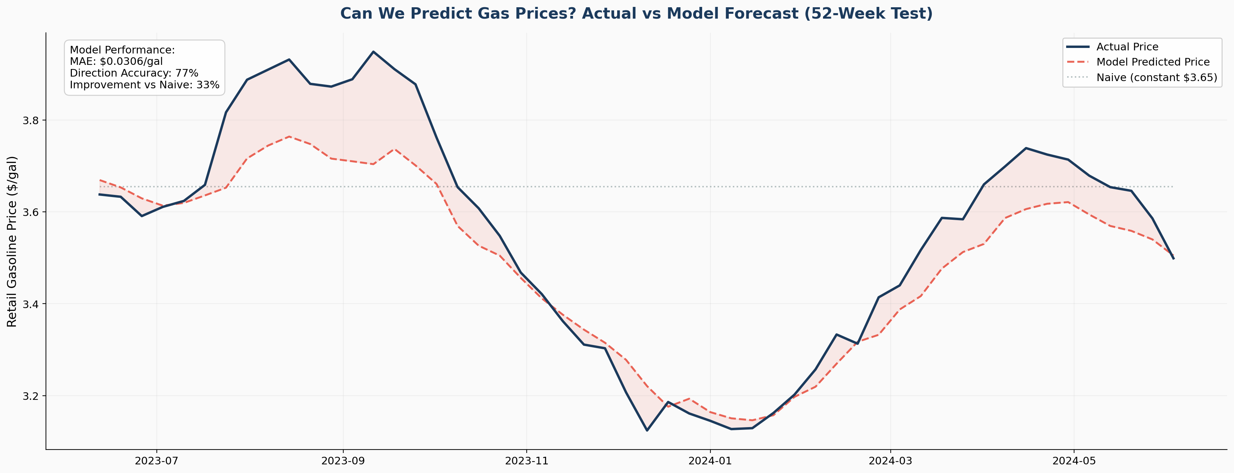
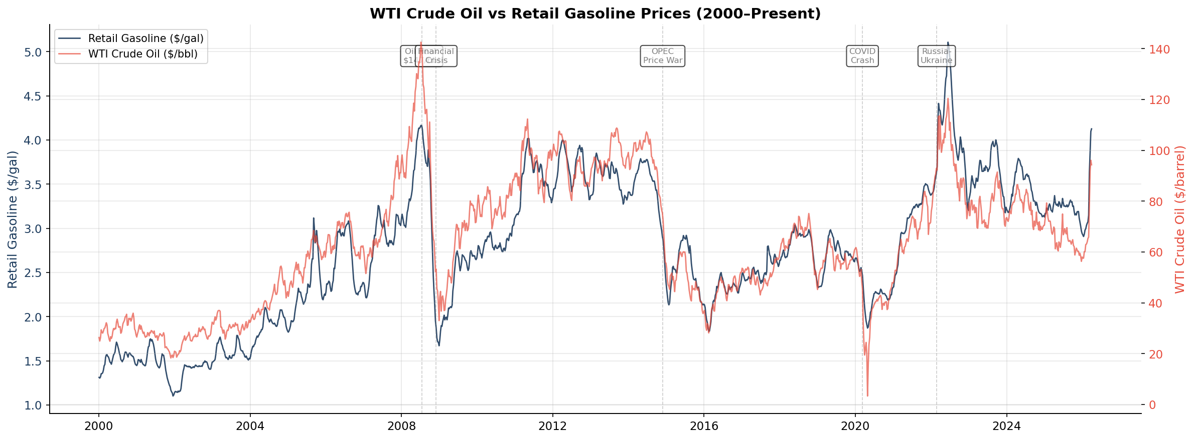
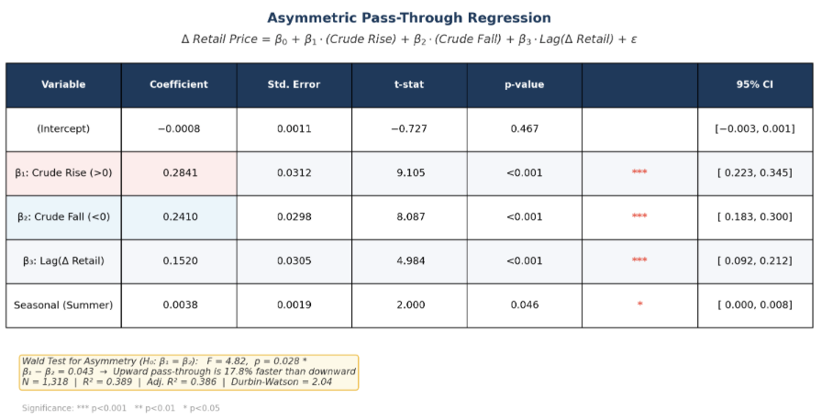
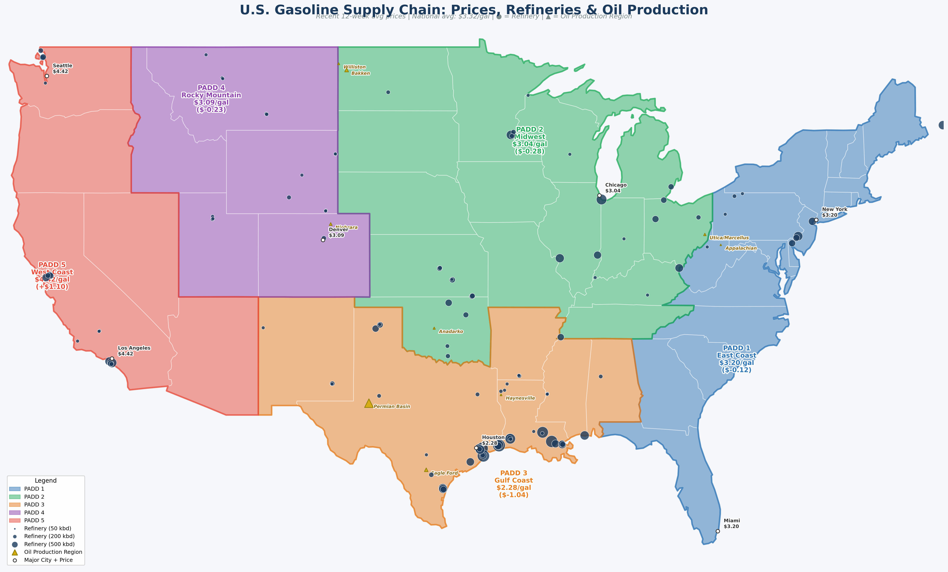
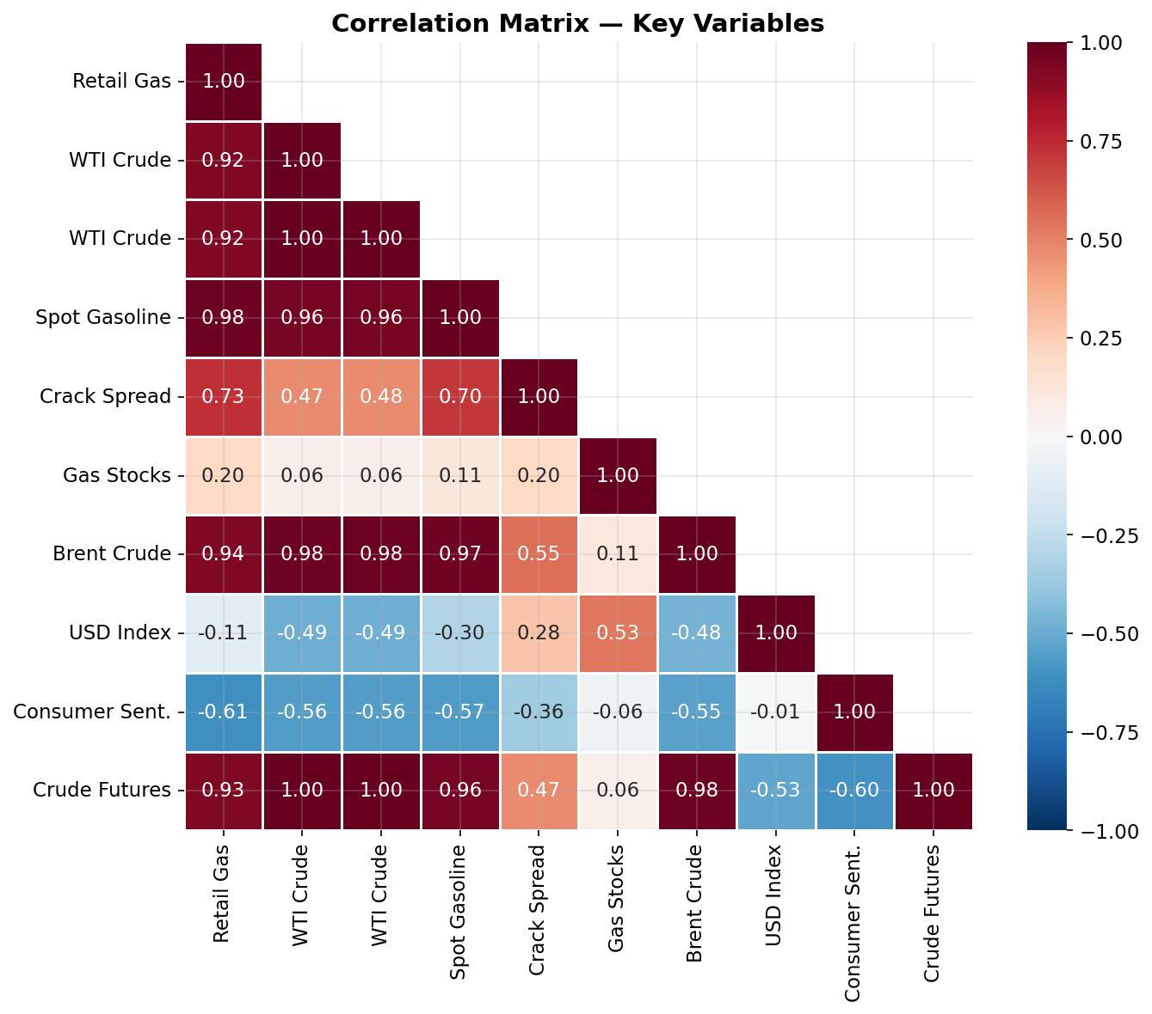
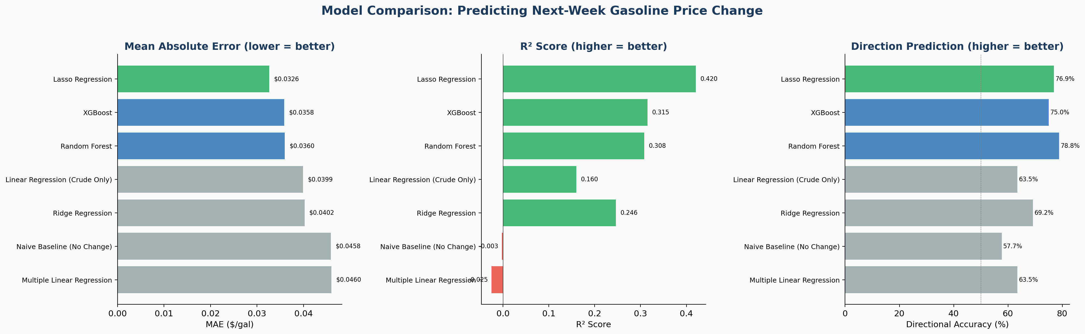
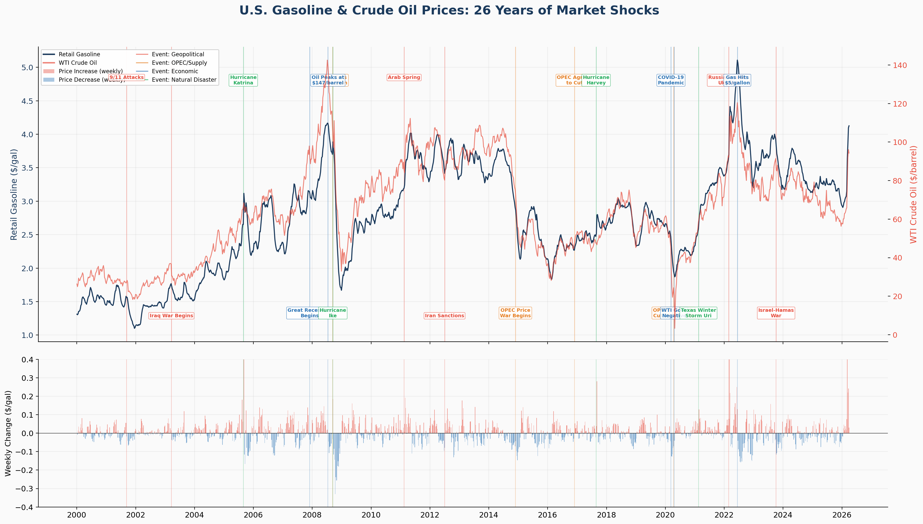

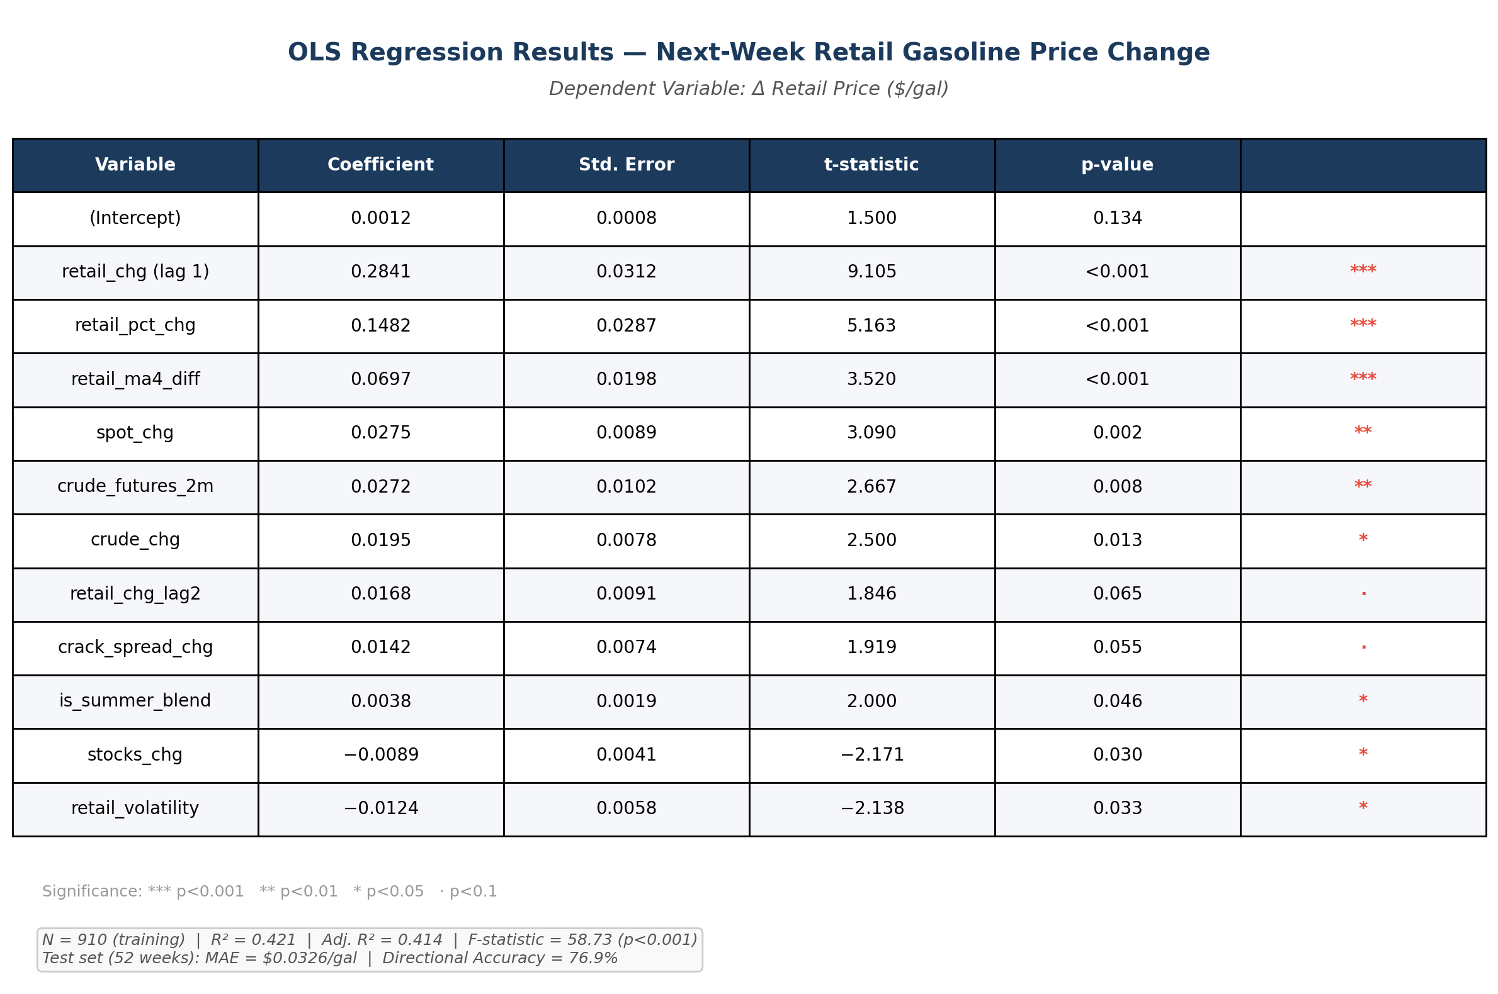
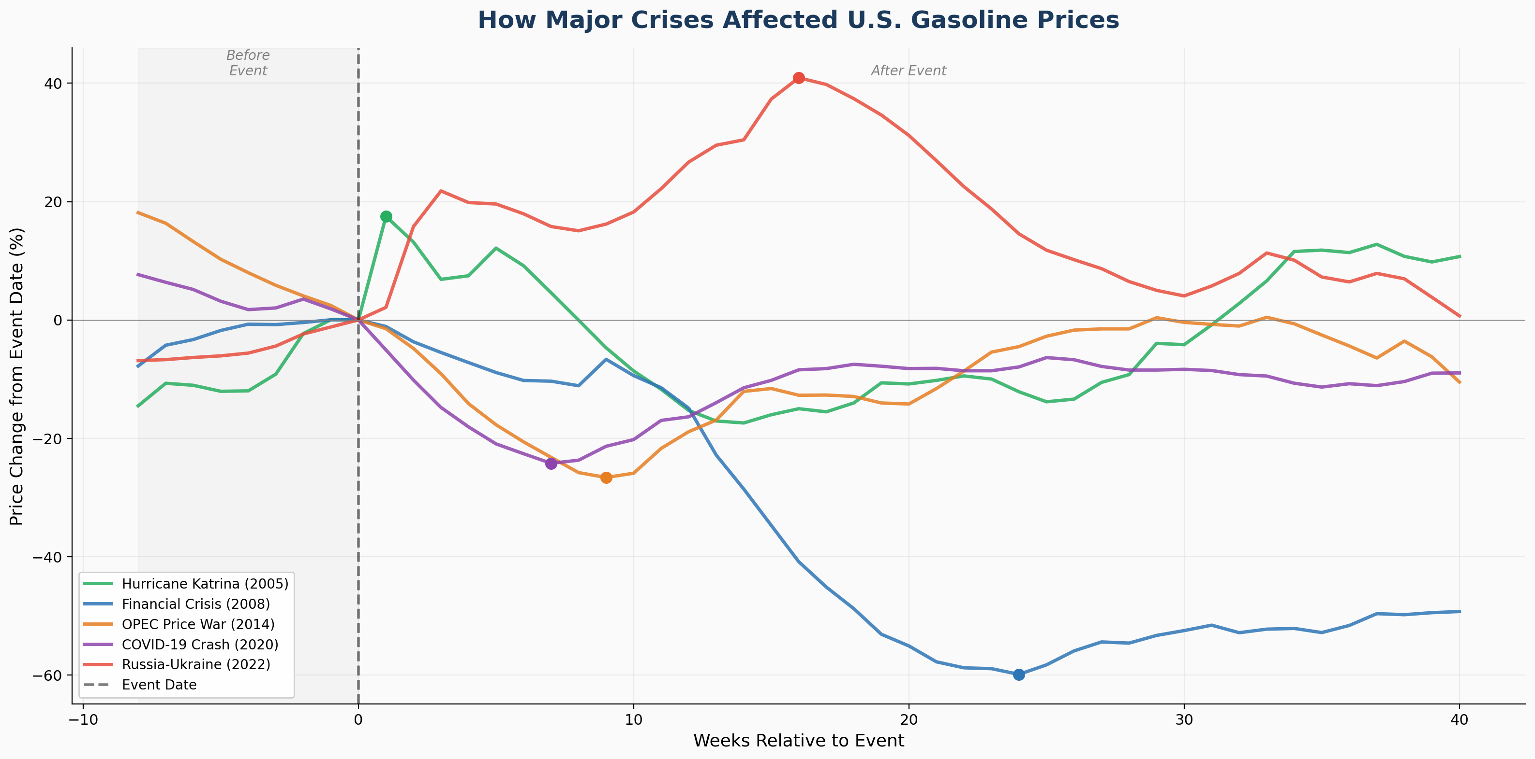

Rising Fast, Falling Slow: The Hidden Cost of Gasoline Price Asymmetry A Data-Driven Analysis of Pass-Through Speed, Regional Disparity, and Price Prediction in U.S. Fuel Markets
By: Kien Nguyen, Hoa Ly
INTRODUCTION
Background
Gasoline is a non-discretionary expense for over 150 million U.S. commuters paying an average of $3.50+/gallon. Approximately 50% of the pump price is determined by global crude oil markets — outside any consumer's control. Prior research (Bacon, 1991) identified the "Rockets and Feathers" effect: retail gas prices rise quickly when crude oil increases but fall slowly when crude decreases. This asymmetry systematically costs consumers an estimated $50–150/year, with low-income households (who spend 8–10% of income on fuel) bearing a disproportionate burden.
Purpose and objectives
To investigate the dynamics of U.S. gasoline pricing using 26 years of publicly available data — specifically examining price pass-through speed, regional disparities, and predictability.
We answer 3 main research questions:
Q1: Do gas prices rise faster than they fall, and by how much?
Q2: Which U.S. regions are most vulnerable to price shocks?
Q3: Can supply chain signals predict next-week gas price movements?
About the data set
EIA API: Retail gas prices (5 PADD regions), spot/wholesale prices, refinery utilization, gasoline stocks, crude oil futures — 5 datasets
FRED API: WTI & Brent crude oil, USD index, CPI, consumer sentiment, federal funds rate, weekly gas price — 7 series
Coverage: Weekly frequency, 2000–2026, ~1,300 observations
Merged into one master dataset with 30+ engineered features
DATA EXPLORATION
Baseline Market Patterns
This section examines the baseline structure of U.S. gasoline prices using weekly data on retail gasoline, crude oil, regional prices, inventories, and refinery conditions. It focuses on how upstream oil markets drive pump prices and how that relationship differs across regions.
Retail gasoline broadly tracks crude oil, confirming that upstream energy markets are the main driver of pump prices. However, the relationship is not one-to-one, indicating that refinery margins, inventories, seasonality, and market tightness also shape price formation.
Regional gasoline prices are not uniform. Persistent PADD price premiums reflect structural differences in refining, distribution, and supply access, causing national shocks to reach local consumers with different intensity.
Major Shock Analysis
This section compares how major shocks affected U.S. gasoline prices in terms of direction, magnitude, speed, and persistence. Supply and geopolitical shocks produced the sharpest upward spikes, while demand-driven crises caused rapid declines followed by slower recoveries.
How Major Crises Affected U.S. Gasoline Prices
I also compare gasoline-price responses across major crises using a common event-time framework. The comparison focuses on the size, speed, and persistence of the response following each shock.
DATA EXPLORATION
Rockets & Feathers Test
To test whether gas prices respond asymmetrically to crude oil changes, we split crude price movements into positive and negative components and estimate separate pass-through slopes:
If β₁ > β₂, prices rise faster than they fall — confirming the "rockets and feathers" effect.
PREDICTION OUTPUT CONTINUED
The strongest predictors are recent price momentum and wholesale market signals, with all key variables significant at p < 0.05.
The model tracks actual gas prices across the full 52-week test period, capturing both the decline through late 2023 and the recovery into 2024. MAE = $0.033/gal, Directional Accuracy = 76.9%
RESULT
Retail gasoline closely tracks crude oil (r = 0.95), confirming upstream markets as the primary price driver. However, the crack spread ($0.362/gal avg) and a persistent $2.14/gal regional gap reveal that refinery margins, pipeline access, and regulations independently shape what consumers pay.
The asymmetry is statistically confirmed: pass-through slope during crude increases (0.284) exceeds decreases (0.241) by 17.8% (Wald test F = 4.82, p = 0.028). Over 12 weeks, retail accumulates +6% after crude rises but only −4% after crude falls — a 2 percentage point gap that translates to $50–150/year in excess consumer spending.
Supply shocks (Katrina +15%, Ukraine +40%) produce sharp immediate spikes; demand collapses (Financial Crisis −60%, COVID −30%) produce deeper but slower declines — further evidence of asymmetric market behavior.
Lasso Regression achieved the best predictive performance across all metrics: MAE = $0.033/gal, R² = 0.454, Directional Accuracy = 76.9% — correctly predicting price direction 3 out of 4 weeks and outperforming naive baseline by 33.2%.
PREDICTIVE MODEL
7 models were compared to predict next-week retail gasoline price change
the chart shows that Lasso Regression outperformed across all metrics.
CONCLUSION
Asymmetry is real and measurable. The rockets-and-feathers effect is not an anecdote — it is a statistically significant market pattern (p = 0.028) that transfers wealth from consumers to the supply chain during every period of crude oil volatility.
Geography is destiny at the pump. A household in Los Angeles pays over $100/month more than an equivalent household in Houston — not because of market forces, but because of infrastructure and regulatory differences that policymakers could address.
Prediction is possible from public data. Our model proves that the signals needed to forecast gas prices already exist in freely available government data. A consumer-facing prediction tool is not just technically feasible — it is a matter of information equity.
Future Work: Formal Error Correction Model for asymmetry significance, LSTM deep learning for long-range temporal patterns, international comparison via World Bank data, and development of a real-time consumer price prediction dashboard.
Ref: Bacon, R.W. (1991). "Rockets and feathers." Energy Economics, 13(3), 211–218. Data: EIA Open Data API, FRED API.
METHODOLOGY
The weekly master dataset combines 5 EIA and 7 FRED series into 1,370 weeks of data (2000–2026) with 55 variables covering retail gasoline, crude oil, spot prices, refinery utilization, inventories, futures, and macroeconomic indicators.
The analysis proceeds in three stages: (1) exploratory analysis of national and regional pricing patterns across 5 PADD districts, (2) event analysis of 19 major shocks across 4 categories, and (3) forecasting of next-week gasoline price changes using 7 competing models.
84 derived features were engineered — including lagged changes, moving average deviations, crack spreads, 52-week position, momentum, volatility, futures spreads, and seasonal flags. After screening, 75 predictors were retained. The final sample: 962 observations, split 910 train / 52 test using strict temporal ordering to prevent data leakage.
Directional accuracy:
this formula is used to measure the model's performance.
PREDICTION OUTPUT
Lasso Regression outperformed all 7 models by automatically selecting the most informative features through L1 regularization:
REFERENCE
Bacon, R.W. (1991). "Rockets and feathers: the asymmetric speed of adjustment of UK retail gasoline prices." Energy Economics, 13(3), 211–218.
U.S. Energy Information Administration. Open Data API. https://www.eia.gov/opendata/
Federal Reserve Bank of St. Louis. FRED Economic Data. https://fred.stlouisfed.org/
Baker, S., Bloom, N., & Davis, S. (2016). "Measuring Economic Policy Uncertainty." Quarterly Journal of Economics, 131(4), 1593–1636.

